Slide 1
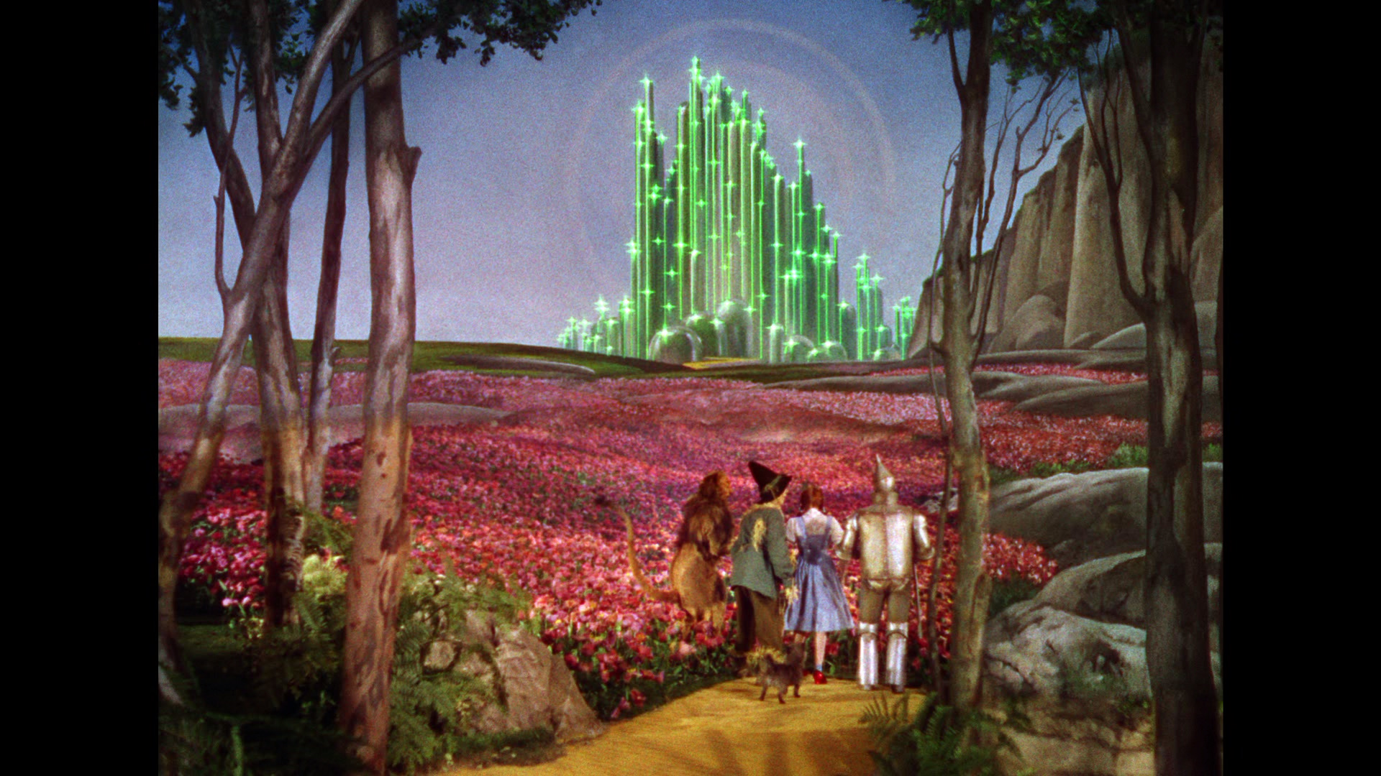
Modern Analog Technique, Novelty, & No-Analogs
Toto, I don’t think we’re in Kansas anymore. – Dorothy
I know it when I see it – Justice Potter Stewart

Slide 2
Outline
Part I: Modern Analog Technique (MAT)
Part II: Complications with the MAT
Part III: Novelty & No-Analogs

Slide 3
The Modern Analog Technique is one of a group of Transfer Functions (Lab 11/18)
All make inferences about past environments from fossil data
Most (all?) are based on space-for-time assumption
MAT explicitly based on dissimilarities, reasoning by analogy
Chevalier et al. 2020 ESR

Slide 4
Modern Analog Technique
Modern Pollen
Samples (S_{j})
Modern
Environments (E_{j})
Modern Analog Technique
1
Spruce
“Deciduous
Forest”
July T=24°C
powerpoint fig
Fossil Pollen
Sample i
Pine
Assumption: if the composition
Reason by analogy: If pollen sample A is similar in composition to pollen sample B, then they are likely to have been drawn from similar communities
Similarity
Oak
2
Spruce
Pine
Spruce
“Mixed
Forest”
July T=20°C
Oak
Pine
Oak
3
Spruce
“Boreal
Forest”
July T=16°C
Pine
Oak
Jackson and Williams, 2004 AREPS

Slide 5
Modern Analog Technique
Modern Pollen
Samples (S_{j})
Modern
Environments (E_{j})
Modern Analog Technique
1
Spruce
“Deciduous
Forest”
July T=24°C
D_{i1}=0.35
powerpoint fig
Fossil Pollen
Sample i
Pine
Assumption: if the composition
Reason by analogy: If pollen sample A is similar in composition to pollen sample B, then they are likely to have been drawn from similar communities
Similarity
Oak
2
Spruce
D_{i2}=0.40
Pine
Spruce
“Mixed
Forest”
July T=20°C
Oak
Pine
Oak
3
Spruce
“Boreal
Forest”
July T=16°C
D_{i3}=0.12
Pine
Oak
Jackson and Williams, 2004 AREPS

Slide 6
Modern Analog Technique
Modern Pollen
Samples (S_{j})
Modern
Environments (E_{j})
Modern Analog Technique
powerpoint fig
Fossil Pollen
Sample i
X
Assumption: if the composition
Reason by analogy: If pollen sample A is similar in composition to pollen sample B, then they are likely to have been drawn from similar communities
Similarity
Spruce
Pine
X
Oak
3
Spruce
“Boreal
Forest”
July T=16°C
Pine
Oak
Jackson and Williams, 2004 AREPS

Slide 7
Modern Analog Technique
Modern Pollen
Samples (S_{j})
Modern
Environments (E_{j})
Modern Analog Technique
powerpoint fig
Fossil Pollen
Sample i
X
Assumption: if the composition
Reason by analogy: If pollen sample A is similar in composition to pollen sample B, then they are likely to have been drawn from similar communities
Similarity
Spruce
Pine
X
Oak
“Boreal
Forest”
July T=16°C
3
Spruce
“Boreal
Forest”
July T=16°C
Pine
Oak
Jackson and Williams, 2004 AREPS

Slide 8
Modern Analog Technique
Modern Pollen
Samples (S_{j})
Modern
Environments (E_{j})
Modern Analog Technique
powerpoint fig
Fossil Pollen
Sample i
X
Assumption: if the composition
Reason by analogy: If pollen sample A is similar in composition to pollen sample B, then they are likely to have been drawn from similar communities
Similarity
Spruce
Pine
X
Oak
“Boreal
Forest”
July T=16°C
3
Spruce
“Boreal
Forest”
July T=16°C
Pine
Oak
Jackson and Williams, 2004 AREPS

Slide 9
MAT Example
2 Taxa (axes)
Many modern samples (circles)
4 fossil samples (diamonds, triangle)
Aridity gradient (color)

Slide 10
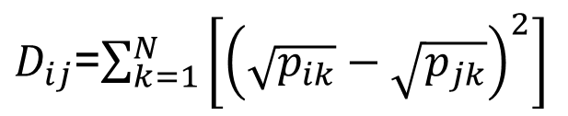
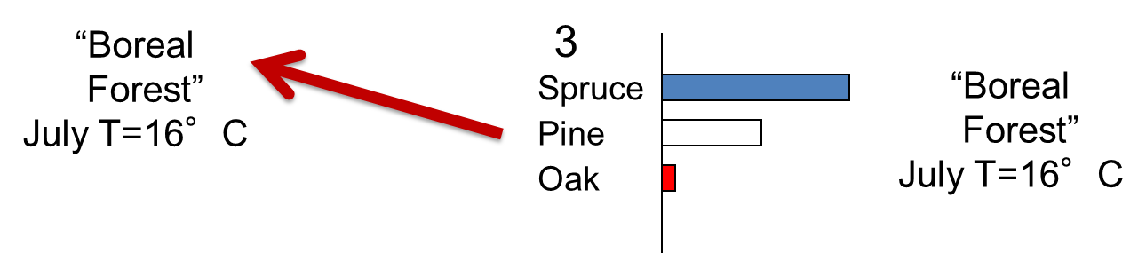
Modern Analog Technique: Key Steps and Parameters
Calculate dissimilarities between i and all modern samples
Discard modern samples with D_{ij}>threshold (d)
Of remaining samples, keep N best analogs
Calculate average environmental variables from N
Assign average environmental values to sample i
Pollen Type 2 (%)
Pollen Type 1 (%)
Notes:
Developed variant of modern analog technique for calibration
Level 1:
-match modern and fossil pollen samples
-close matches get assigned tree densities associated w/modern
-no matches=classic problem for analog approaches
-here, regroup into functional categories (e.g. spruce and fir regrouped to boreal conifers)
Level 2: rerun analysis
Level 3: regroup to very broad categories -- but didn’t work
Key point: allows finding of functional analogs when no compositional analogs exist

Slide 11
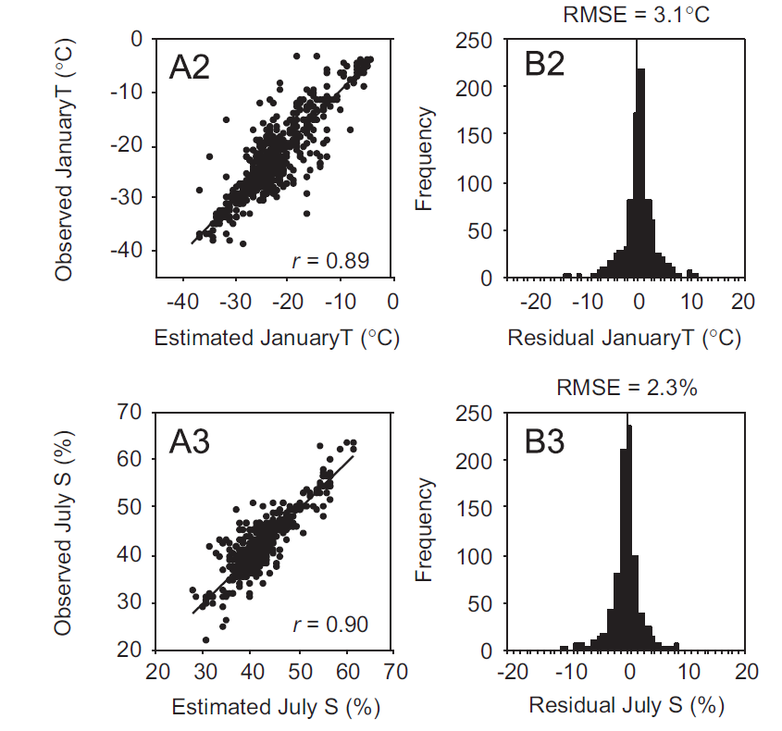
Cross-Validation: Leave-One-Out Technique
Frechette et al. 2008 QSR

Slide 12
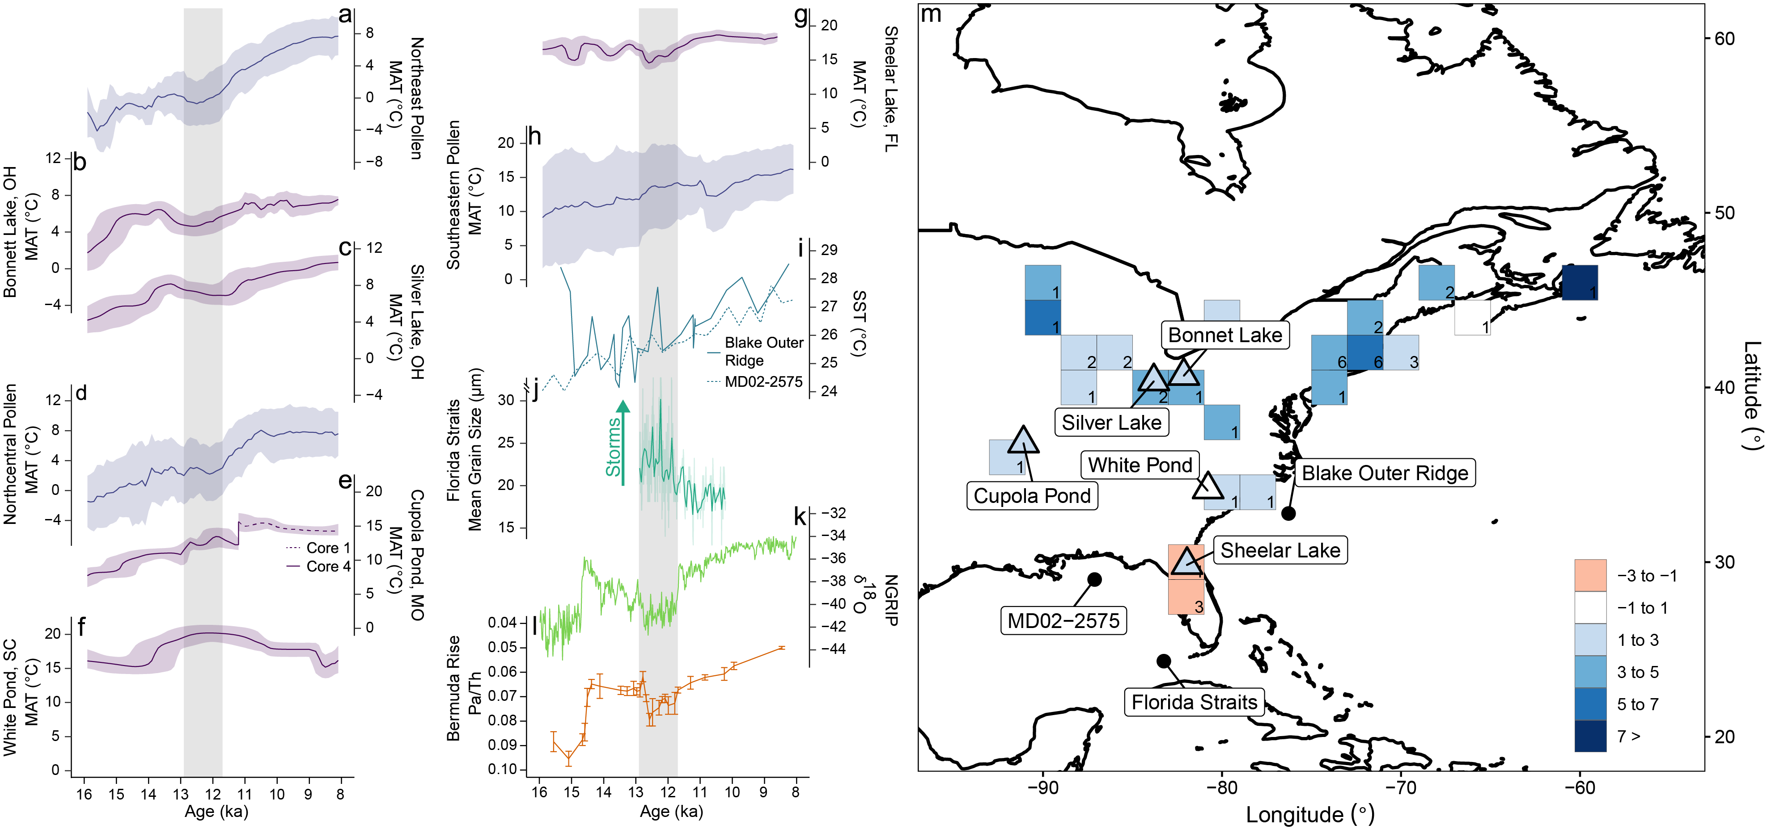
Reconstruction: Example
Time Series
Blue = pollen & MAT
Purple = brGDGT
Map
Squares = pollen & MAT
Triangles = brGDGT

Slide 13
Outline
Part I: Modern Analog Technique (MAT)
Part II: Complications with the MAT
Part III: Novelty & No-Analogs

Slide 14
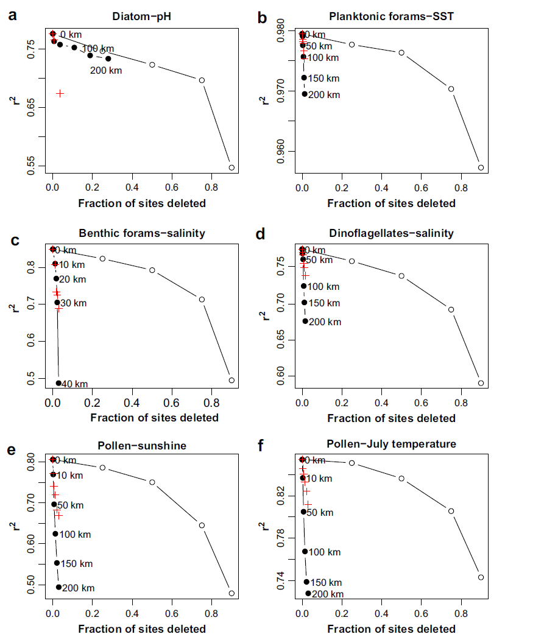
1. Spatial Autocorrelation: Leads to overestimates of explanatory power during cross-validation
Cross-Validation Tests
Sites deleted randomly
Closest sites deleted
Environmentally similar sites deleted
+
Significance Tests
(relative to random variable with spatial structure)
Telford and Birks 2009 QSR

Slide 15
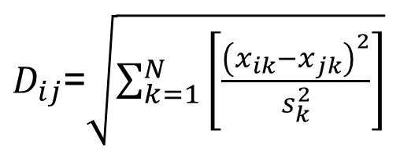
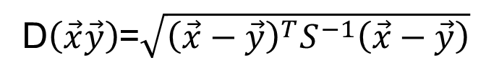
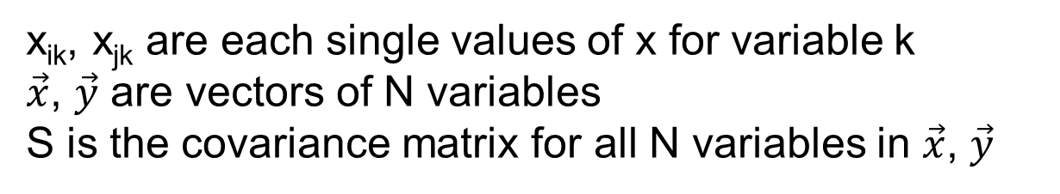
2. Correlations among variables
$D_{ij}$=$\sqrt{\sum_{k=1}^{N}{\left[\frac{{\left(x_{ik}−x_{jk}\right)}^{2}}{s_{k}^{2}}\right]}}$
Covariance among variables leads to double-counting
Standardized
Euclidean
Mahalanobis downweights by covariance matrix
Mahalanobis
D$\left(\vec{x}\vec{y}\right)$=$\sqrt{{\left(\vec{x}−\vec{y}\right)}^{T}S^{−1}\left(\vec{x}−\vec{y}\right)}$
If there are no correlations among variables, Mahanobis reduces to Standardized Euclidean
x_{ik}, x_{jk} are each single values of x for variable k
$\vec{x}$, $\vec{y}$ are vectors of N variables
S is the covariance matrix for all N variables in $\vec{x}$, $\vec{y}$

Slide 16
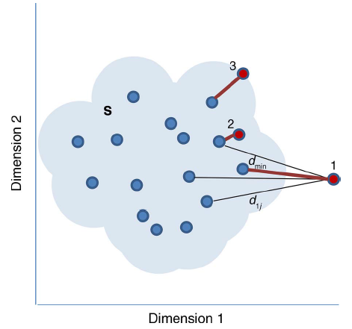
3. The No Analog Problem: All modern samples are poor matches for fossil sample
Under the MAT, no inference can be made when a sample lacks a modern analog
Radeloff, Williams et al., 2015 Ecological Applications
Notes:
Developed variant of modern analog technique for calibration
Level 1:
-match modern and fossil pollen samples
-close matches get assigned tree densities associated w/modern
-no matches=classic problem for analog approaches
-here, regroup into functional categories (e.g. spruce and fir regrouped to boreal conifers)
Level 2: rerun analysis
Level 3: regroup to very broad categories -- but didn’t work
Key point: allows finding of functional analogs when no compositional analogs exist

Slide 17
Outline
Part I: Modern Analog Technique (MAT)
Part II: Complications with the MAT
Part III: Novelty & No-Analogs

Slide 18
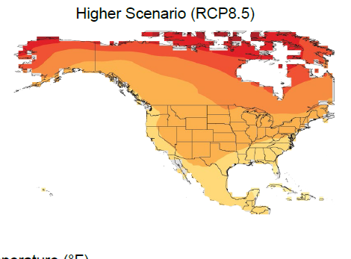
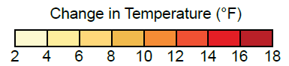
Magnitude, Rate, Novelty
MAGNITUDE
How much is a system changing?
RATE
How fast is a system changing?
NOVELTY
How novel is the new system state?
Magnitude (T₁-T₂)
US Fourth National Climate Assessment (NCA4), 2017

Slide 19
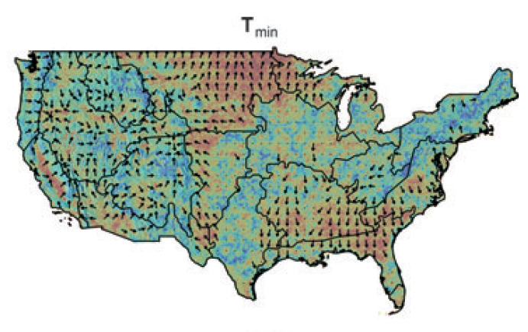
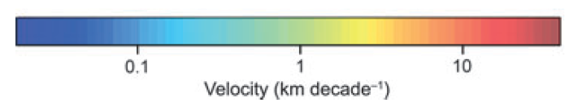
Magnitude, Rate, Novelty
MAGNITUDE
How much is a system changing?
RATE
How fast is a system changing?
NOVELTY
How novel is the new system state?
Rate (ºC/yr or km/yr)
Climate Velocities, T_{min}
Dobrowski et al. 2013, GCB

Slide 20
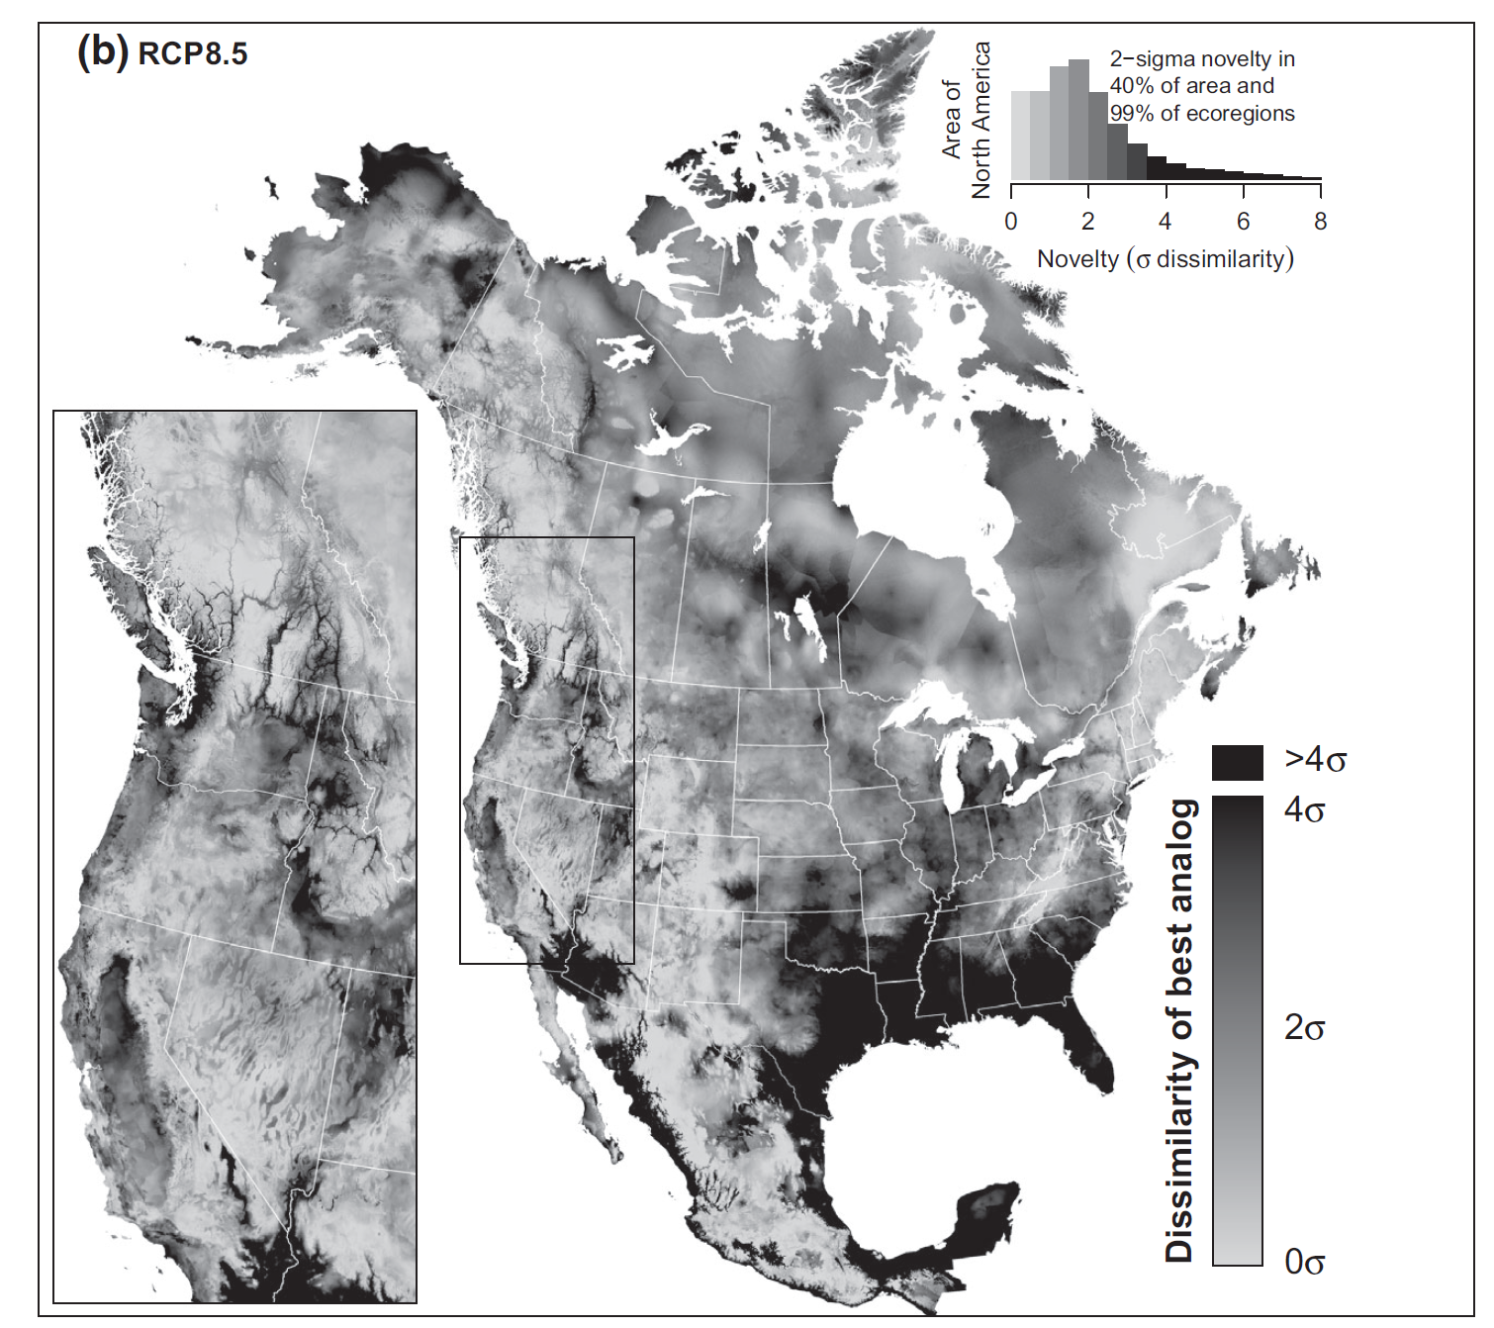
Magnitude, Rate, Novelty
MAGNITUDE
How much is a system changing?
RATE
How fast is a system changing?
NOVELTY
How novel is the new system state?
Climate Novelty of North America
2071-2100 vs. 1971-2000
Mahony et al., 2016

Slide 21
Defining Novelty
Novelty = min(D_{ij})
Novelty is the degree of dissimilarity of a system, measured in one or more dimensions relative to a reference baseline, usually defined as the present or recent past.
General Considerations
Continuous, not categorical
Requires specifying variables (dimensions) for measuring novelty
Requires a reference baseline
Flexible – can apply to present/past/future
Radeloff, Williams et al. 2016 Ecol Apps

Slide 22
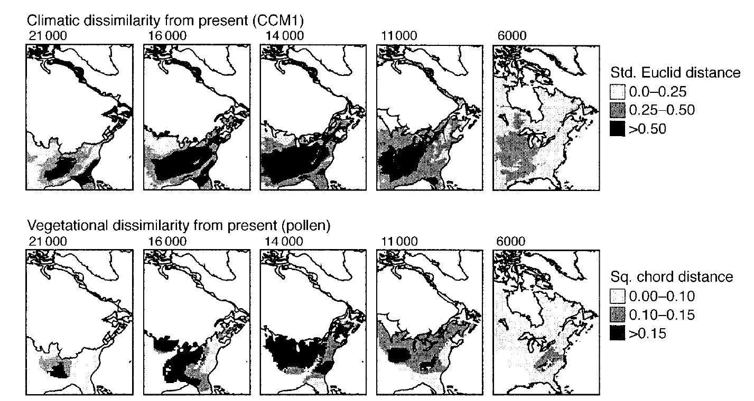
Mapping Climate and Vegetation Novelty: Past
Williams et al. 2001 Ecology

Slide 23
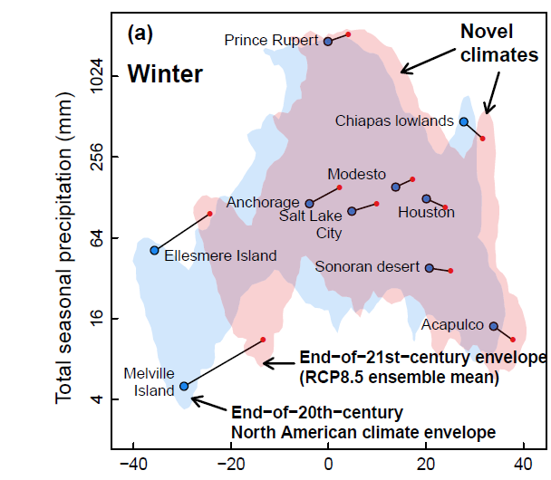
Mapping Climate Novelty: Future
Colin Mahony Visit Apr 9-10!
Mahony et al., 2016

Slide 24
No-Analogs:
No-Analog: min(D_{ij})>D_{threshold}
General Considerations
Categorical, Not Continuous
Requires calculation of novelty (min(D_{ij}))
Requires a D_{threshold}
No-analog communities consist of species that are extant today, but in combinations not found at present. “No-analog” is therefore shorthand for “no present analog.” … No-analog fossil assemblages also have been called “disharmonious”, “mixed”, “intermingled”, “mosaic”, or “extraprovincial” assemblages (Graham 2005).
Text: Williams and Jackson 2007 Frontiers Ecology Environment
Fig: Radeloff, Williams et al., 2015 Ecological Applications

Slide 25
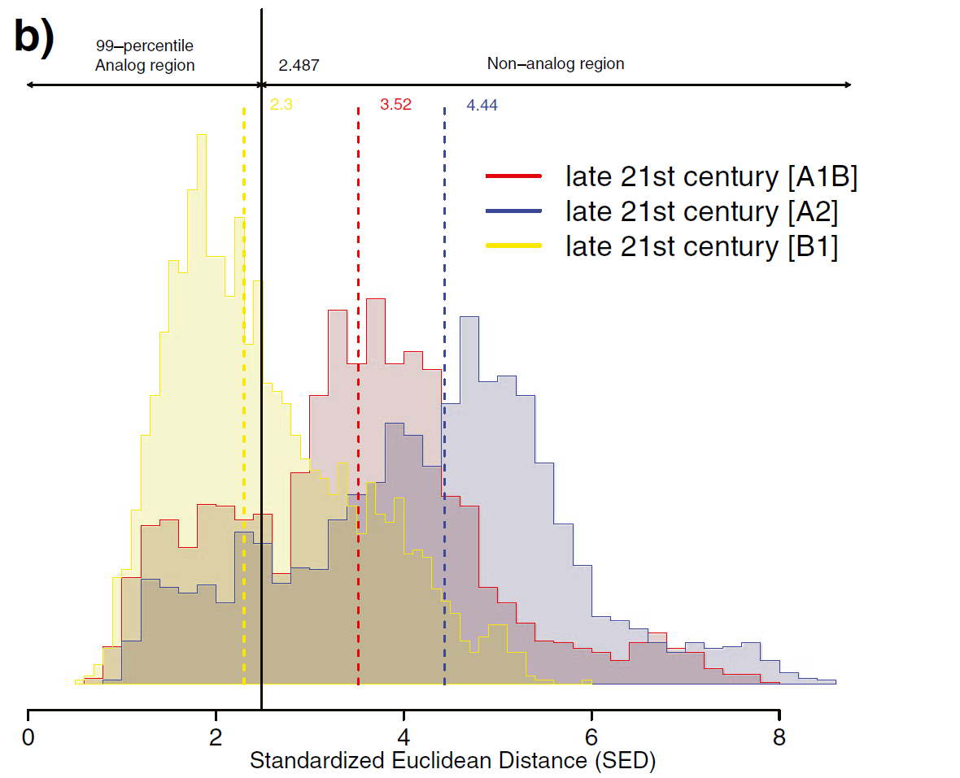
How to set D_{threshold}?
Option 1: Set to 99% percentile of all modern pairwise dissimilarities
Based on pairwise dissimilarities of WI gricells and 20th-century climates
Pros
Standard Stats
Can use data at hand
Cons
Arbitrary threshold
Almost all Future Climates in WI are No-Analog (relative to 20th-century WI)
Ordonez & Williams 2013
Climatic Change

Slide 26
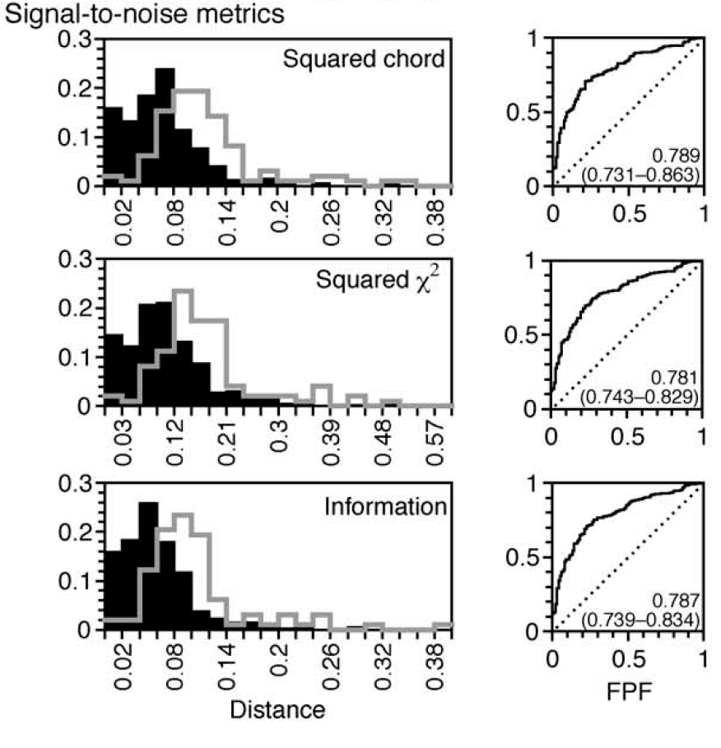
How to set D_{threshold}?
Option 2: Set to D_{opt} based on ROC analysis & some ecologically meaningful categories (e.g. same-biome vs different-biome pairs
ROC Curves
Pros
More ecologically meaningful
Cons
Requires independently categorized data
Embedded assumptions about scale
D_{opt}
Black Histograms
D_{ij}: Same-biome pairs
Open Histograms
D_{ij}: Different-biome pairs
TPF
ROC Curves
Tradeoff between TPF and FPF
Total area under the curve indicates overall performance of metric
D_{opt} will be point on curve closest to upper left
D_{opt}
TPF
D_{opt}
TPF
Gavin et al., 2003 Quaternary Research

Slide 27
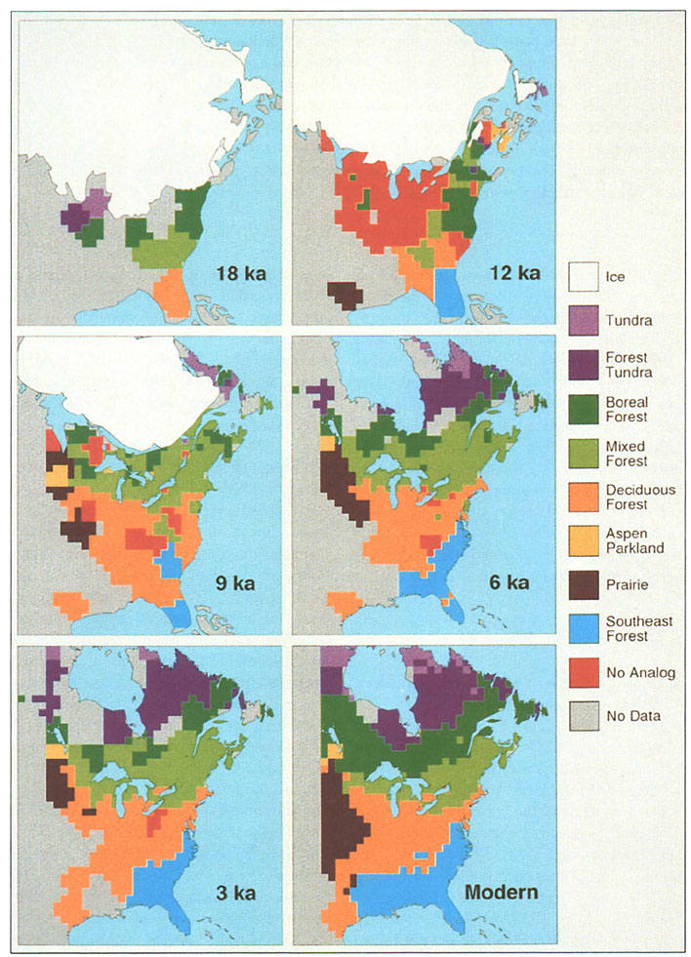
Example: No-Analog Vegetation
Overpeck et al., 1992 Geology

Slide 28
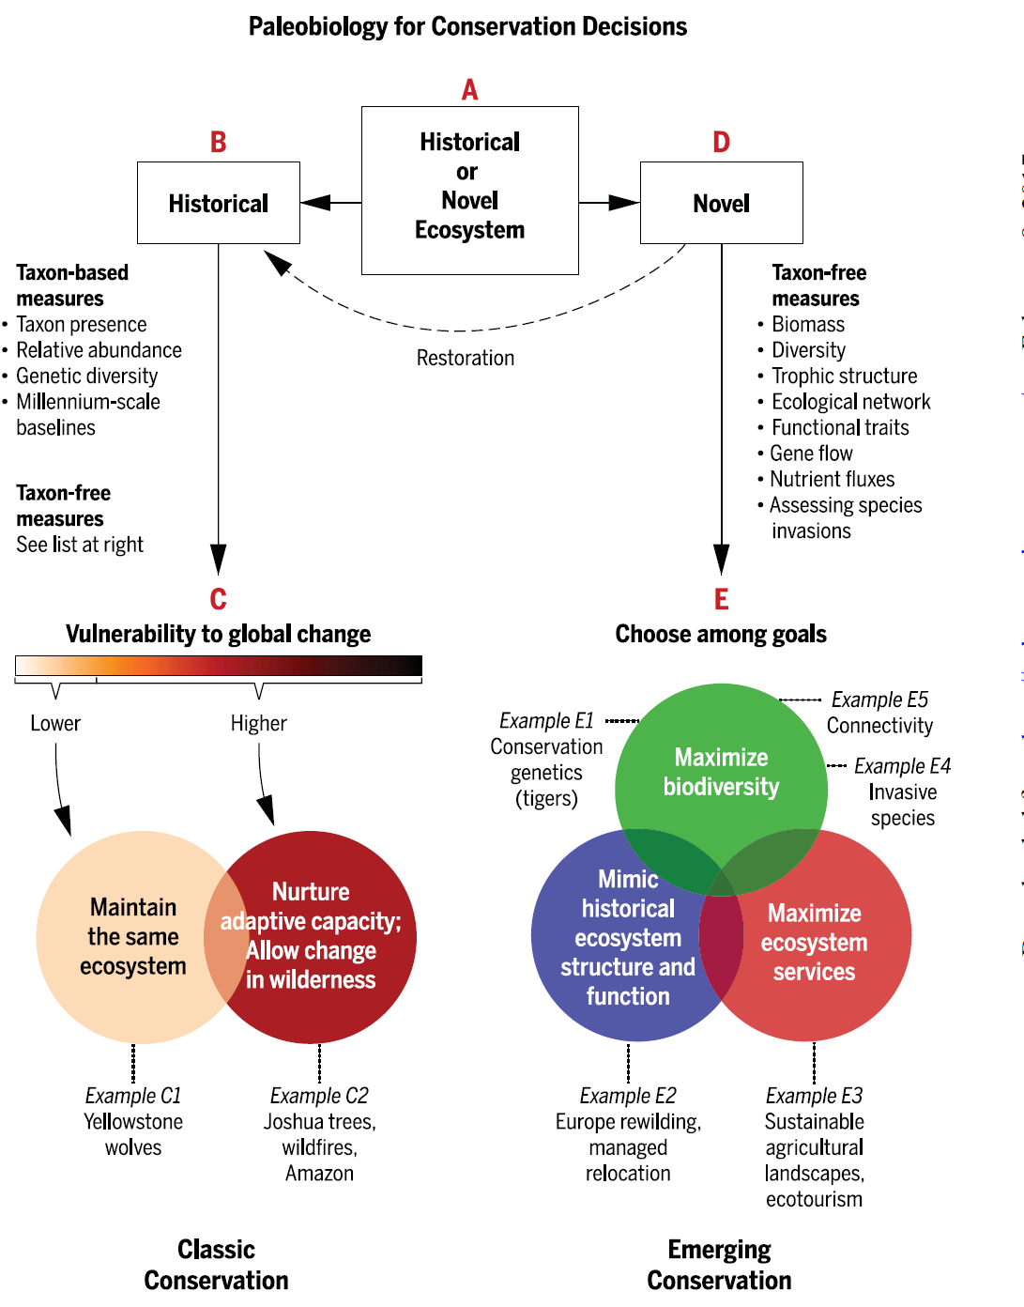
Why Novelty Matters: Conservation Decisions
Barnosky et al. 2017, Science

Slide 29
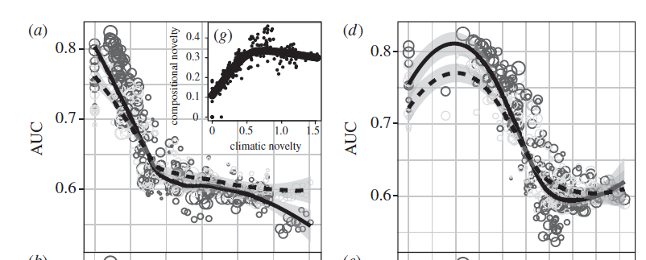
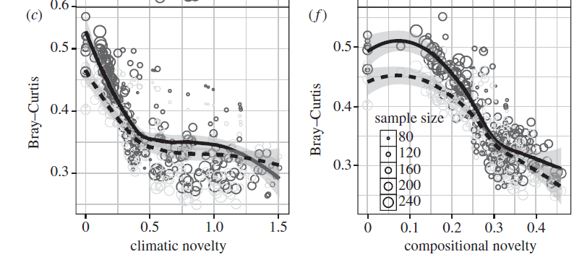
Why Novelty Matters: Ecological Forecasting
Predictive ability of species distribution models decreases as climate & community novelty increases
Maguire et al. 2016, Proc Roy Soc B

Slide 30
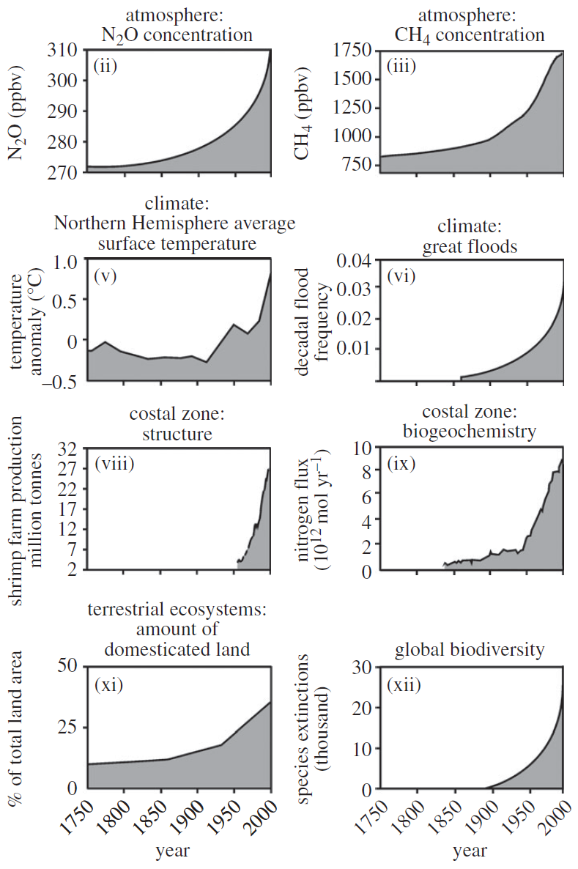
Why Novelty Matters: Updating our Language
We live in a dynamic world… but our language & conceptual frameworks are riddled with assumptions about static, equilibrial systems
Historical Baselines
Historic Ranges
Restoration
Resilience
Invasive Species
…. novelty helps us think about a world that is ever-changing, and ever-new

Slide 32
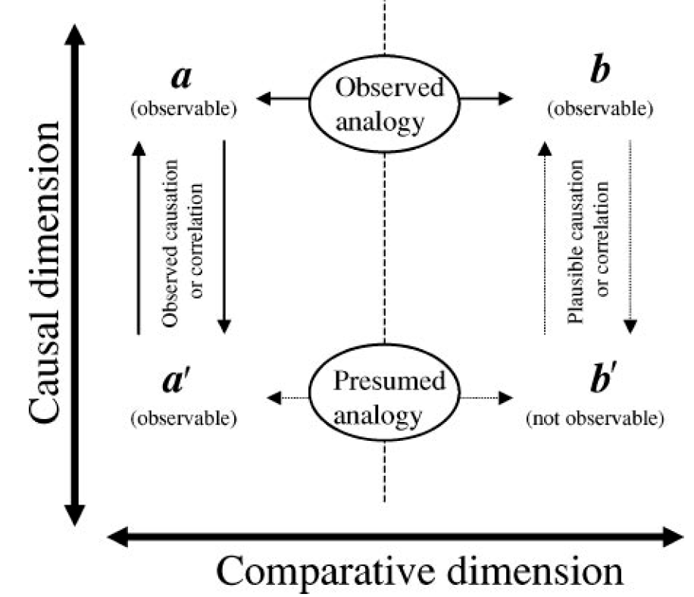
Reasoning by Analogy
SITE A
(PRESENT)
SITE B
(PAST)
Modern Vegetation Composition
Modern Pollen Assemblage
POLLEN
Past
Vegetation Composition
Fossil Pollen Assemblage
VEGETATION
Jackson & Williams 2004 AREPS
Jackson and Williams, 2004 AREPS

